Slide 1
CHARMS USER GUIDE
H-B Woodlawn Music Department
Created in 2022
Notes:
Line spacing + Page numbers

Slide 2
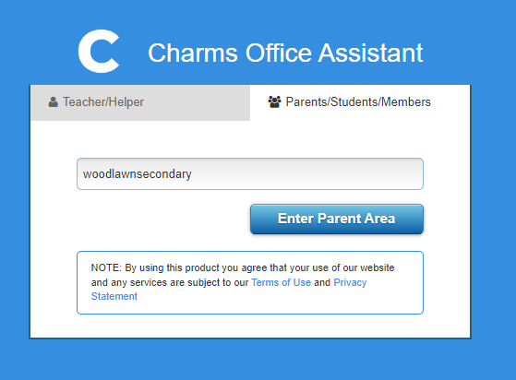
First Time User
Go to https://www.charmsoffice.com/charms2/login.asp
Select the Parents/Students/Members tab
Then enter in HBW’s school code: woodlawnsecondary
Finally, click on the Enter Parent Area button

Slide 3
OOPs?
If you find yourself on this Login page (https://www.charmsoffice.com/), do not fret!
Just click on the LOGIN button in the top right-hand corner to advance to the page that looked like the previous slide.

Slide 4
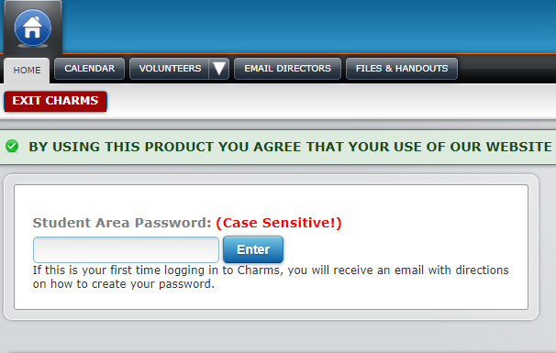
Once you enter the Parent Area, you should see this screen: Enter your Student Area Password, then click Enter. If you are new to CHARMS, your APS Student ID will be your Student Area Password. After you first log in, you will be asked set-up a Student Area Password and Hint.

Slide 5
If you used CHARMS last school year, your Student Area Password is the one that you set last year. If you have forgotten your password, email your music teacher to reset your password back to your child’s APS Student ID number.
Returning Families

Slide 6
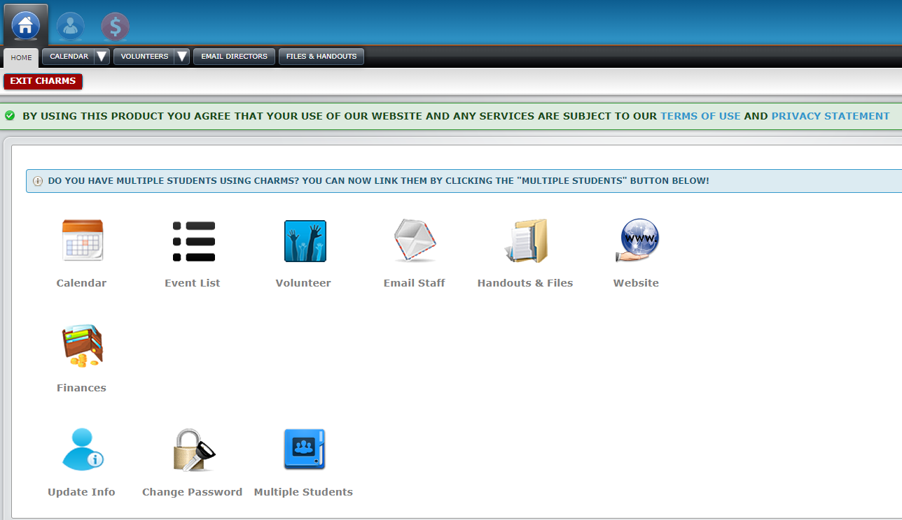
Once you enter CHARMS, the top right-hand side will show the Student’s name. Here, we have Ludwig Van Woodlawn! On the main menu, you can update your contact info, change passwords, or check finances.

Slide 7
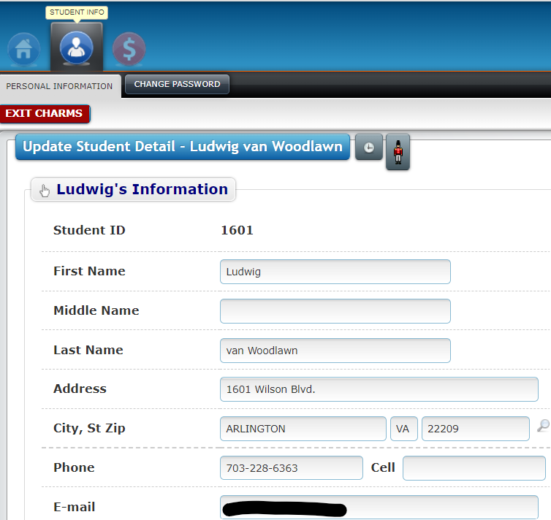
Make sure your Student’s info is listed correctly and update accordingly!

Slide 8
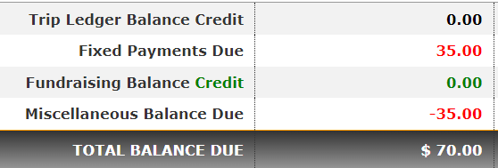
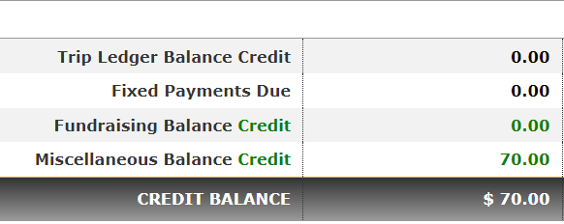
Returning families are recommended to check if they have any carryover balances. Carryover balances are shown in the Miscellaneous Balance Due line. Red is a balance owed, while Green is a balance credit.
Returning Families — Check Finances First!

Slide 9
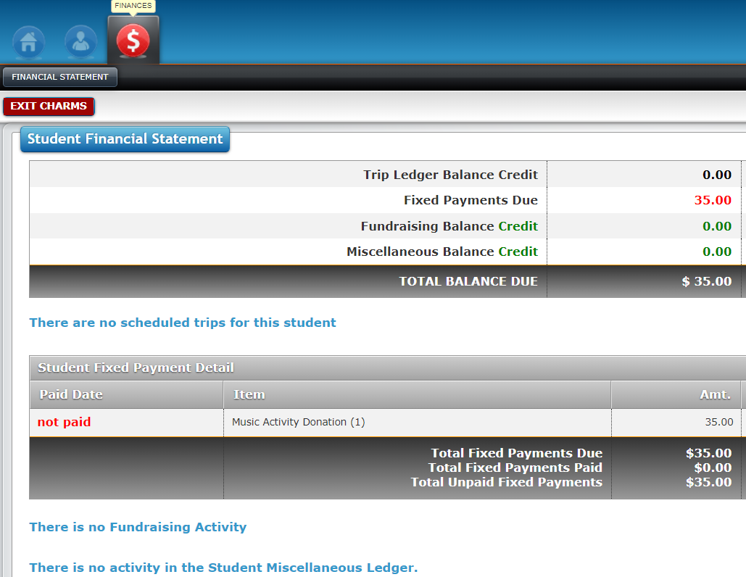
Within Finances, you can view your Student’s total balance. At the beginning of the year, fixed payment charges will be billed to your Student, such as the $35.00 music activity fee. If your Student fundraises, then a balance will show up in the Fundraising Activity section. If your Student owes fees, please send in a check or pay on the APS online payment portal.

Slide 10
Once you have paid your Student’s fees, the paid by information should appear in your Student’s section. Here, Ludwig van Woodlawn, Sr. paid $35.00 for the Music Activity fee by check. The balance now reflects $0.00 monies owed.

Slide 11
Click on the Home button to return to the main menu. Or Click on Exit Charms when you are done!

Slide 12
Should you have any questions about CHARMS, please feel welcomed to ask us! Please email our Music Department Parent Treasurer, Mary Tang at ucascva@gmail.com if you have financial statement questions. We hope this helps you navigate CHARMS easier! The use of CHARMS helps us keep track of our many music department activities!

